Slide 1
© 2018 Cengage Learning®. May not be scanned, copied or duplicated, or posted to a publicly accessible website, in whole or in part.

Slide 2
Why Is Marketing Management Important?
1
© 2018 Cengage Learning.® May not be scanned, copied or duplicated, or posted to a publicly accessible website, in whole or in part.
2

Slide 3
Discussion Questions #1
What is the definition of marketing?
What can be marketed?
3

Slide 4
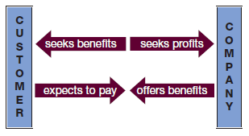
Marketing Defined
Marketing is defined as an exchange between a firm and its customers
4

Slide 5
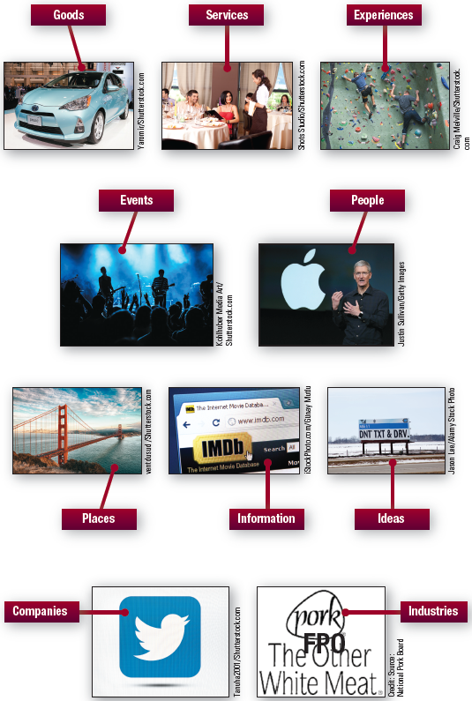
What Can We “Market”?
5

Slide 6
Evolution of Modern Marketing
Product/production orientation
Focus on building a better gadget
Sales orientation
Focus on convincing the customer that your product works best for them
Customer orientation
Focus on identifying customers’ wants BEFORE formulating attractive solutions
6

Slide 7
Discussion Questions #2
Which orientation do you think would mostly likely lead to an exchange?
Who do you think is responsible for marketing?
7

Slide 8
Who Is Responsible for Marketing?
Marketing and customer satisfaction is everyone’s responsibility
Marketing should permeate the firm
Accounting/finance
Sales
Research and development
8

Slide 9
Reasons to Measure Marketing Success
Pressure to show results
Ensure that the chief marketing officer (CMO) carries as much weight as the CEO, CFO, or COO
9

Slide 10
Measuring Marketing Success (slide 1 of 2)
Quantify results when possible
Sometimes the effectiveness of marketing programs is easy to quantify
Did the coupon promotion lift sales?
Measure the percentage sales increase, etc.
Did the direct mail campaign increase web usage?
Measure the number of web visits, etc.
10

Slide 11
Measuring Marketing Success (slide 2 of 2)
However, sometimes the effectiveness is not easy to quantify
Was the segmentation study effective?
Difficult to quantify
Did the advertising campaign increase sales?
Difficult to quantify because great advertising is geared toward long-term brand building not short-term results
11

Slide 12
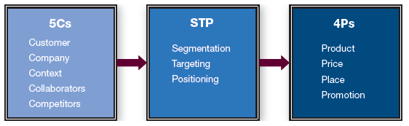
Marketing Management Framework
The 5Cs, STP, and the 4Ps constitute the marketing management framework
12

Slide 13
5Cs (slide 1 of 3)
Customer
The firm’s current and potential customers
What are current customers’ preferences, buying trends, etc.?
What are potential customers’ preferences? Should they be targeted?
Company
The firm’s capabilities, resources, etc.
What does it do well?
What doesn’t it do well?
13

Slide 14
5Cs (slide 2 of 3)
Context
Macro-environmental forces facing the firm
What is going on politically or legally that might affect the firm?
What is going on with the economy that might affect the firm?
What trends are occurring in society that might affect the firm?
What technological innovations might affect the firm?
14

Slide 15
5Cs (slide 3 of 3)
Collaborators
The companies/people firm works with
Are these relationships strong? Can these relationships be improved or leveraged?
Competitors
The companies/people firm works against and how they compare to the firm in terms of resources, capabilities, customer preferences, reaction patterns, etc.
15

Slide 16
STP
Segmentation
Grouping customers with similar needs
Targeting
Pursuing segment who makes the most sense for the firm
Positioning
Communicating product’s benefits clearly to the intended target
Developed through the 4Ps
16

Slide 17
4Ps (slide 1 of 2)
Product
Goods or services customers need or want
What should constitute your product mix? What features and benefits should comprise each product?
Price
How much should you charge given your costs, competitive pricing, and customer demand?
17

Slide 18
4Ps (slide 2 of 2)
Place
How will you get the product into the customers’ hands? Will you go directly to customers or use channel partners?
Promotion
What communications mix will you use to communicate with your targets? What message will you use?
18

Slide 19
Considerations (slide 1 of 2)
The situation facing the company changes over time
Customer preferences change
Competitors change offerings
Government passes new laws, etc.
Firm must consistently monitor the 5Cs
19

Slide 20
Considerations (slide 2 of 2)
5Cs, STP, and 4Ps are interdependent
As contextual factor changes, what would the impact be on distribution channels?
As a collaborator shifts their demands, what will that do to our pricing structure?
As our company sells off a nonperforming function, what impact might that have on our positioning and customer satisfaction?
Marketers must understand the interdependencies
20

Slide 21
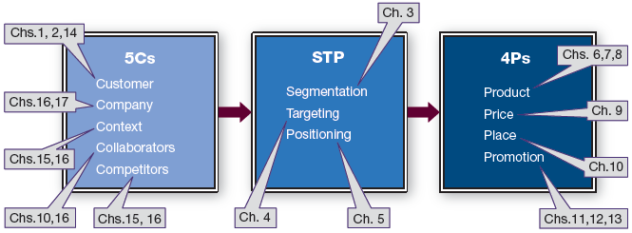
Book Layout
21

Slide 22
Flow of Each Chapter
Each chapter covers the “What,” “Why,” and “How.”
What is the topic in this chapter?
Why does it matter?
How do I do this?
22

Slide 23
Managerial Recap (slide 1 of 2)
Marketing can make customers happier and companies more profitable
Marketing is about trying to find out what customers would like, providing it to them, and doing so profitably
Marketing facilitates a relationship between customers and a company
23

Slide 24
Managerial Recap (slide 2 of 2)
Just about anything can be marketed
The marketing management framework—5Cs, STP, 4Ps—will structure the book
If you can remain customer-centric, you’ll be five steps ahead of the competition
24

